Slide 1
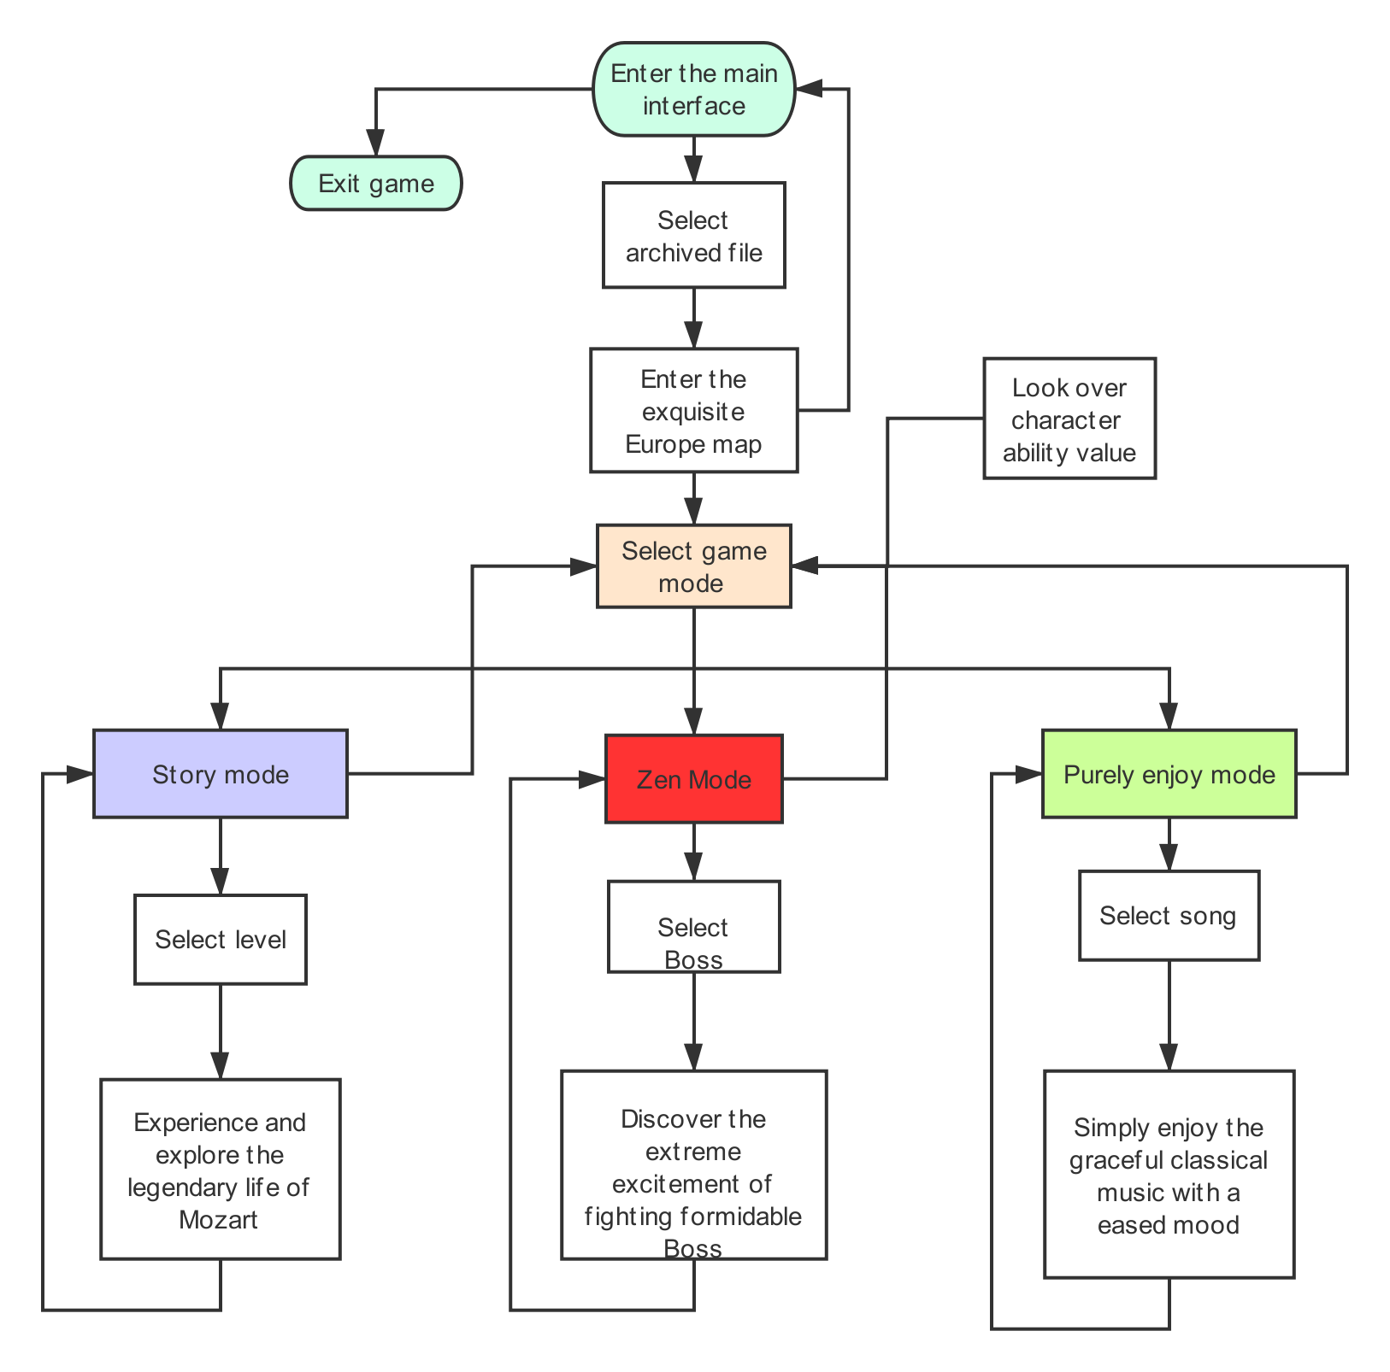
在此输入您的封面副标题

Slide 2
API and Techniques
Game engine:Unity
Map-making,3-D modeling:MagicaVoxel
UI design,Art design:Photoshop,Procreate,Omnigraffle etc.
Database:mySQL
Logic design,Programming:Visual Studio ect.
Music Score design:FL Studio

